Slide 1

Stock and Crypto Management System
INFS 740 – Final Project
Abhishek Jallawaram (G01373042) Teja Sajja (G01395837)

Slide 2

Tech Stack
React
FastAPI
MongoDB

Slide 3
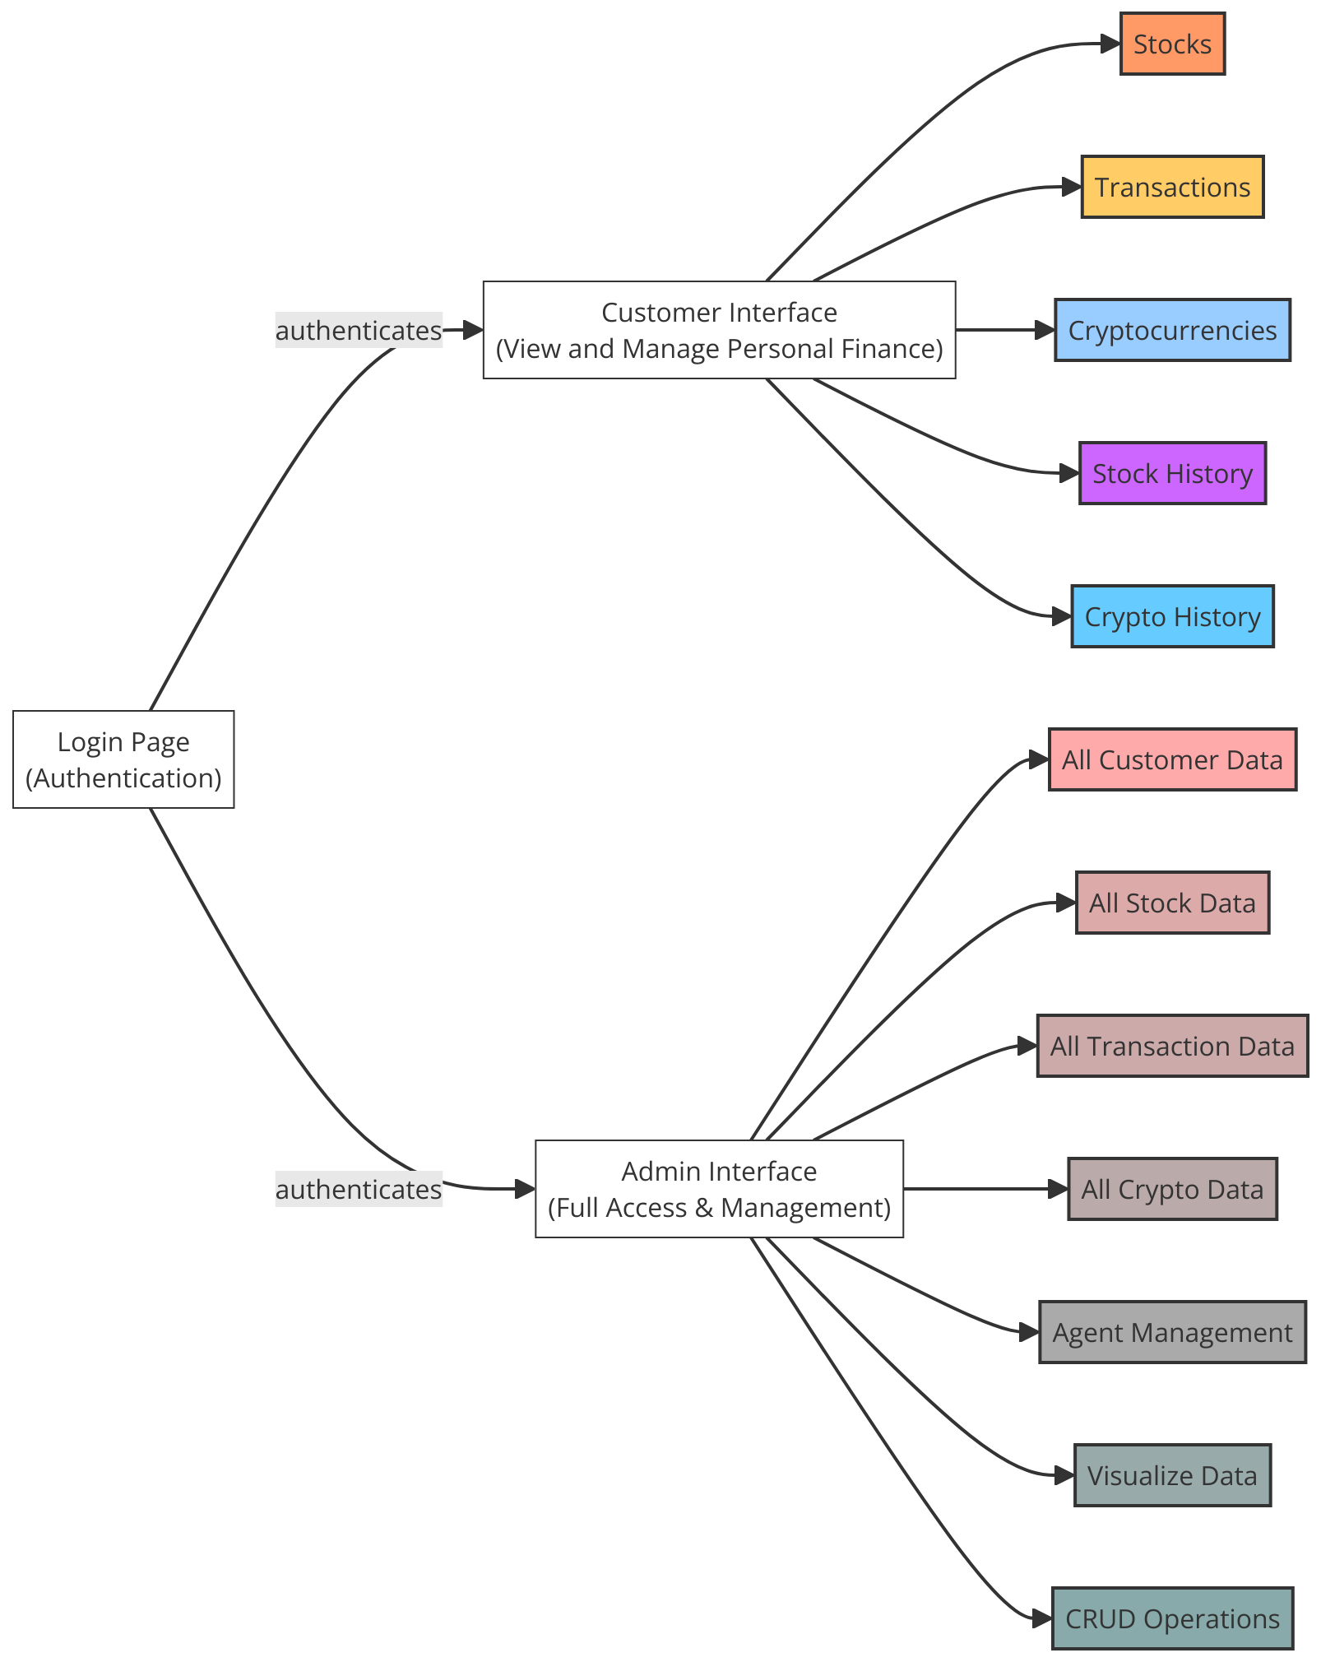
System Architecture

Slide 4

Collections
Agents
Customers
Transactions
Stock History
Stocks
Crypto History
Cryptocurrencies

Slide 5

Agents
_id
agent_id
name
contact
level

Slide 6

Customers
_id
customer_id
username
email
balance
Net_stock

Slide 7

Transactions
_id
transaction_id
stock_id
crypto_id
agent_id
ticket
volume
each_cost
action

Slide 8

StocKs
_id
company_name
company_ticker
company_info
company_pe
Company_dividends
company_cashflow
agent_id

Slide 9

Stock History
_id
open
close
high
low
adj close
volume
company_ticker
date

Slide 10

cryptocurrencies
_id
name
symbol
last_close
market_cap
volume_24hr
circulating_supply
crypto_id

Slide 11

Crypto History
_id
open
close
high
low
adj close
volume
symbol
date

Slide 12

CRUD Operations Complex Queries Visualizations ML Prediction Recommendation Systems

Slide 13
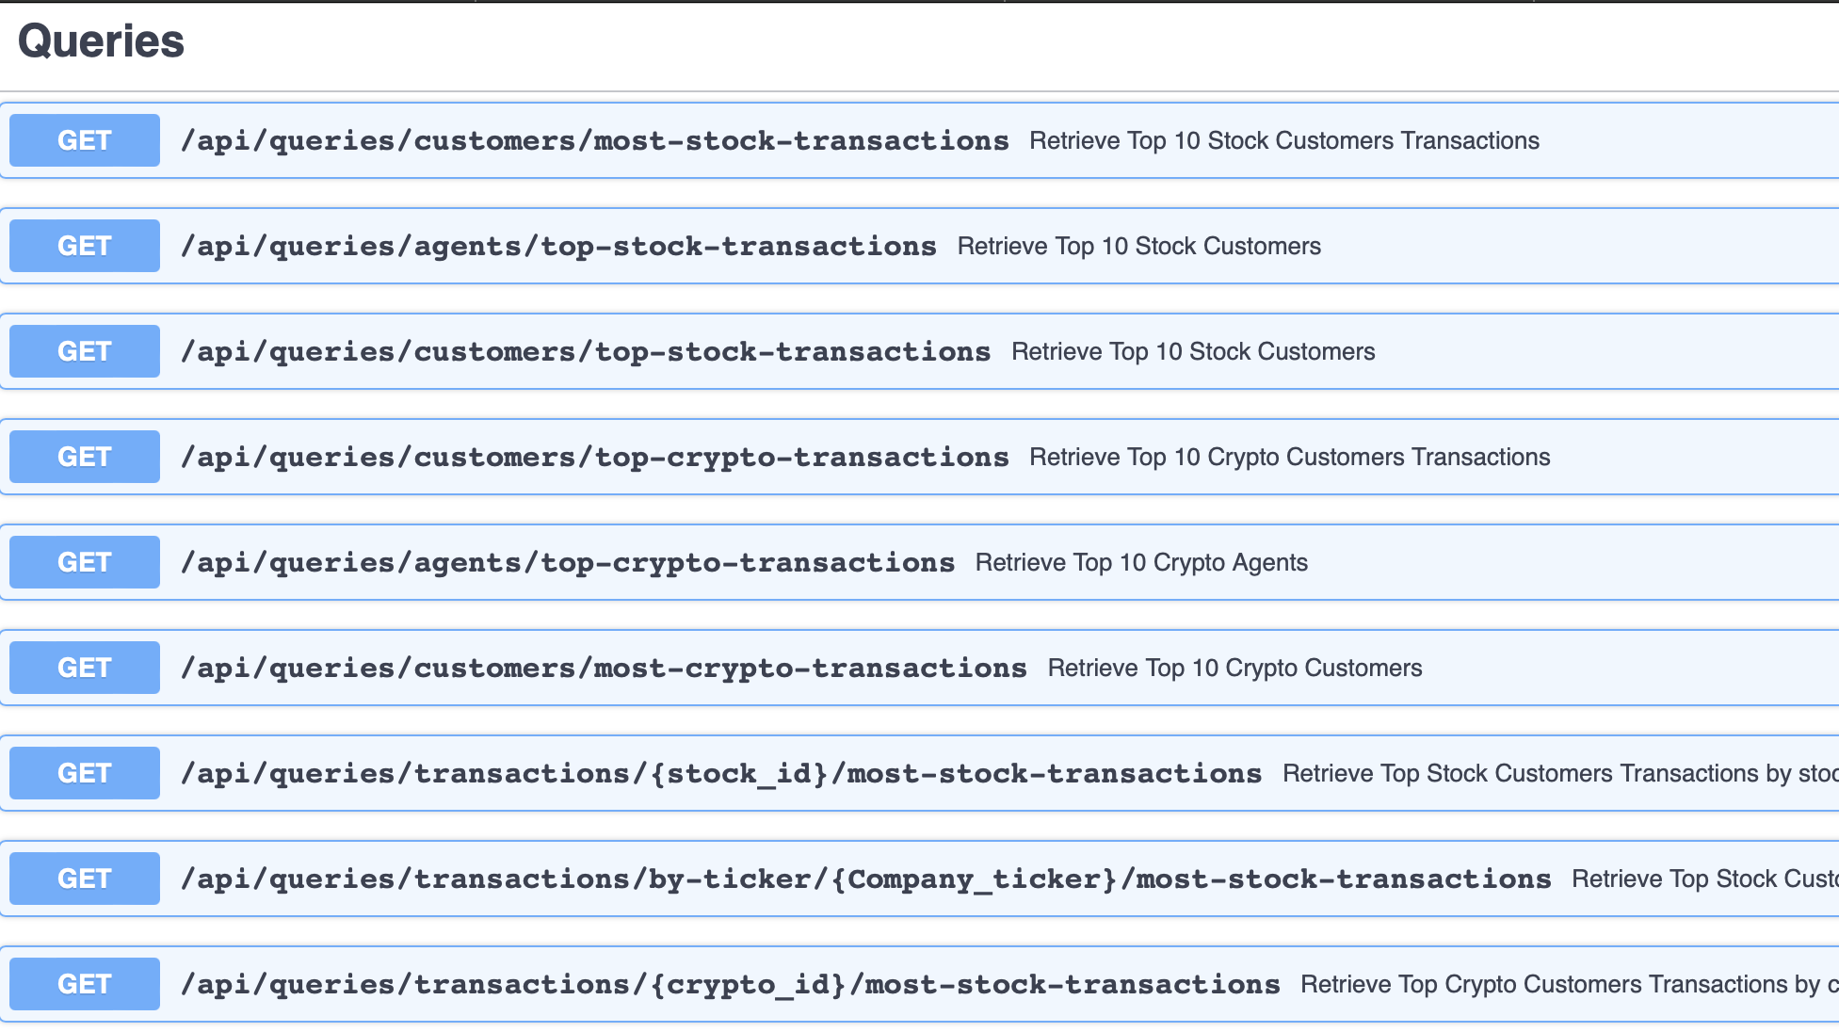

Slide 14
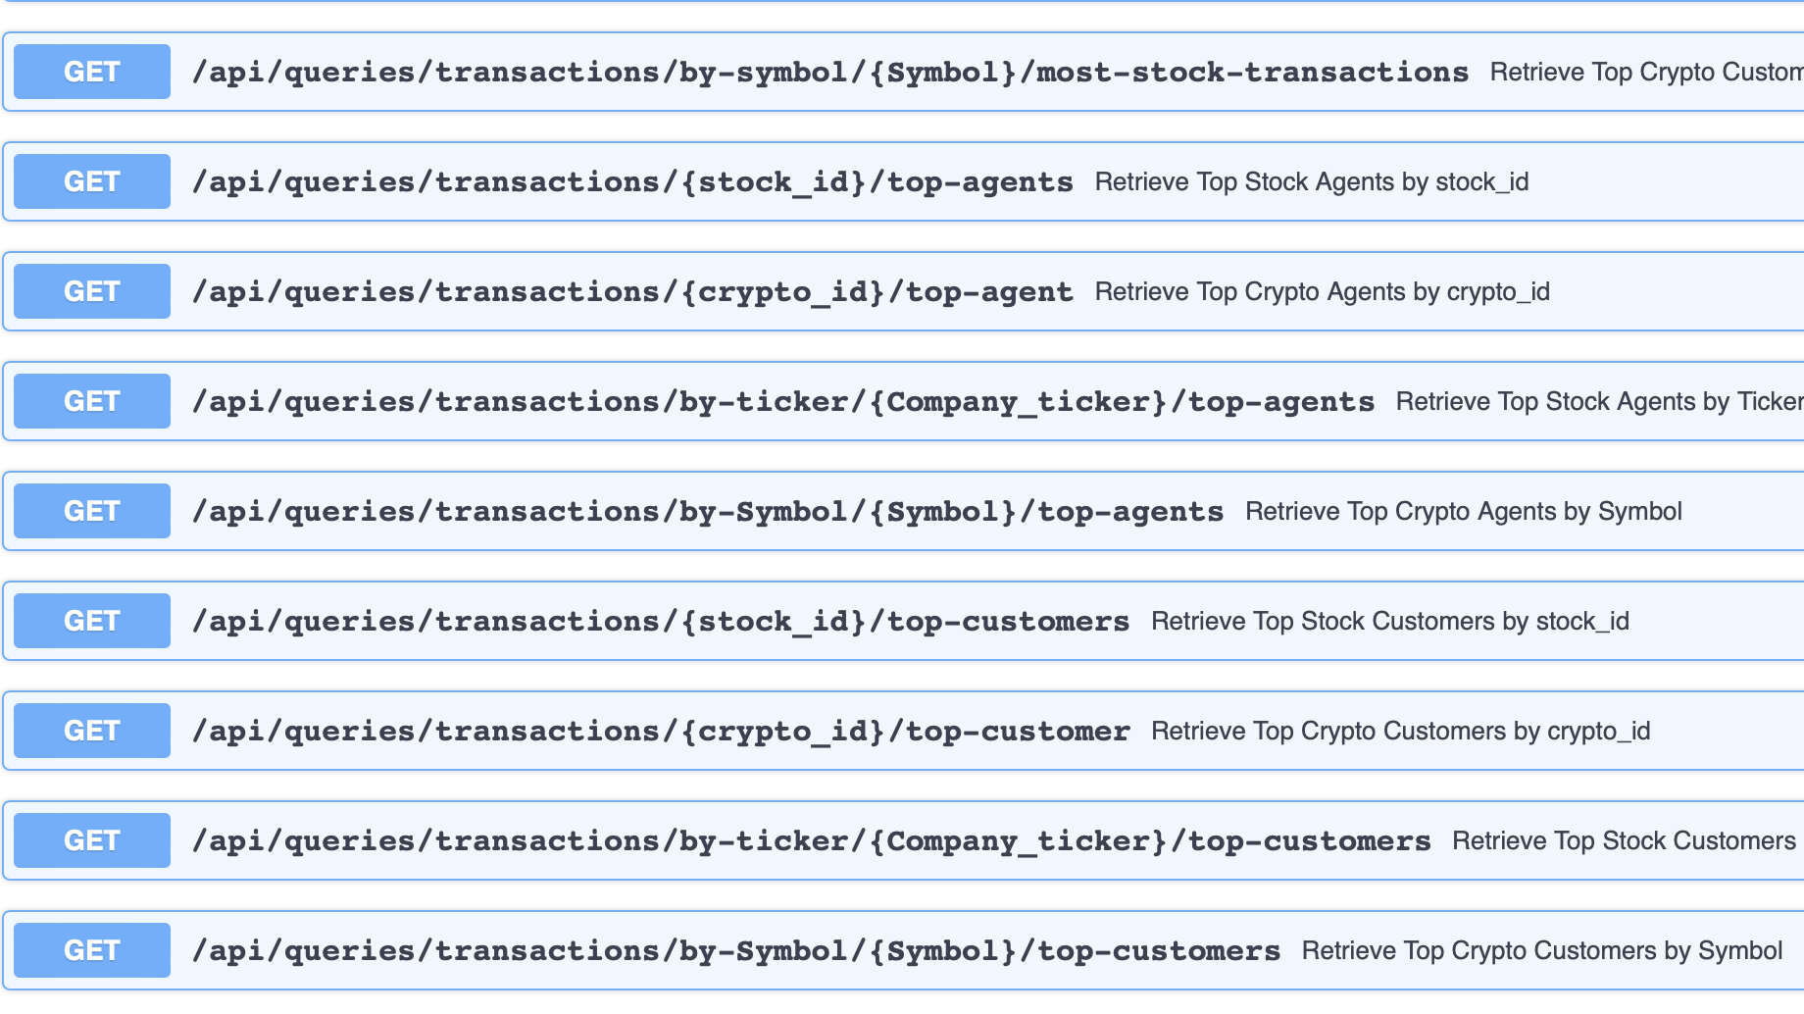

Slide 15

Query1: Customers with Most Transactions in the Platform with Stocks Data
Collections:
1) Transactions
2) Stocks
3) Customers
4) Agents
Variations: 1) For a specific stock_id
2) For a specific company

Slide 16
Query2: Customers with Top Transactions in the Platform with Stocks Data
Collections:
1) Transactions
2) Stocks
3) Customers
4) Agents
Variations: 1) For a specific stock_id
2) For a specific company

Slide 17
Query3: Agents with Top Transactions in the Platform with Stocks Data
Collections:
1) Transactions
2) Stocks
3) Customers
4) Agents
Variations: 1) For a specific stock_id
2) For a specific company

Slide 18
Query4: Customers with Most Transactions in the Platform with Crypto Data
Collections:
1) Transactions
2) Cryptocurrencies
3) Customers
4) Agents
Variations: 1) For a specific crypto_id
2) For a specific Cryptocurrency

Slide 19
Query5: Customers with Top Transactions in the Platform with Crypto Data
Collections:
1) Transactions
2) Cryptocurrencies
3) Customers
4) Agents
Variations: 1) For a specific crypto_id
2) For a specific Cryptocurrency

Slide 20
Query6: Agents with Top Transactions in the Platform with Crypto Data
Collections:
1) Transactions
2) Cryptocurrencies
3) Customers
4) Agents
Variations: 1) For a specific crypto_id
2) For a specific Cryptocurrency

Slide 21

ML - Predictions
Stock Data Prediction using Keras for a given Ticker and a given date. Predict the next 10 days of Close price for the given ticker and calculate the RMSE.

Slide 22
Live Demo

